Slide 1
Safe Tactical Approach and Response
TRAINING OUTLINE
PREPARED OCTOBER 2021

Slide 2
Purpose of this document
This Training Outline serves the following purposes:
Provide an overview of the structure of Safe Tactical Approach and Response (STAR) training
Provide an overview of the key topic areas to be covered in Safe Tactical Approach and Response (STAR) training
A document to ‘sense-check’ against as training is developed to ensure we design to what is agreed
Outline the key frameworks and values that need to be present throughout the training material
Identify topics where will require SME support to complete the development

Slide 3
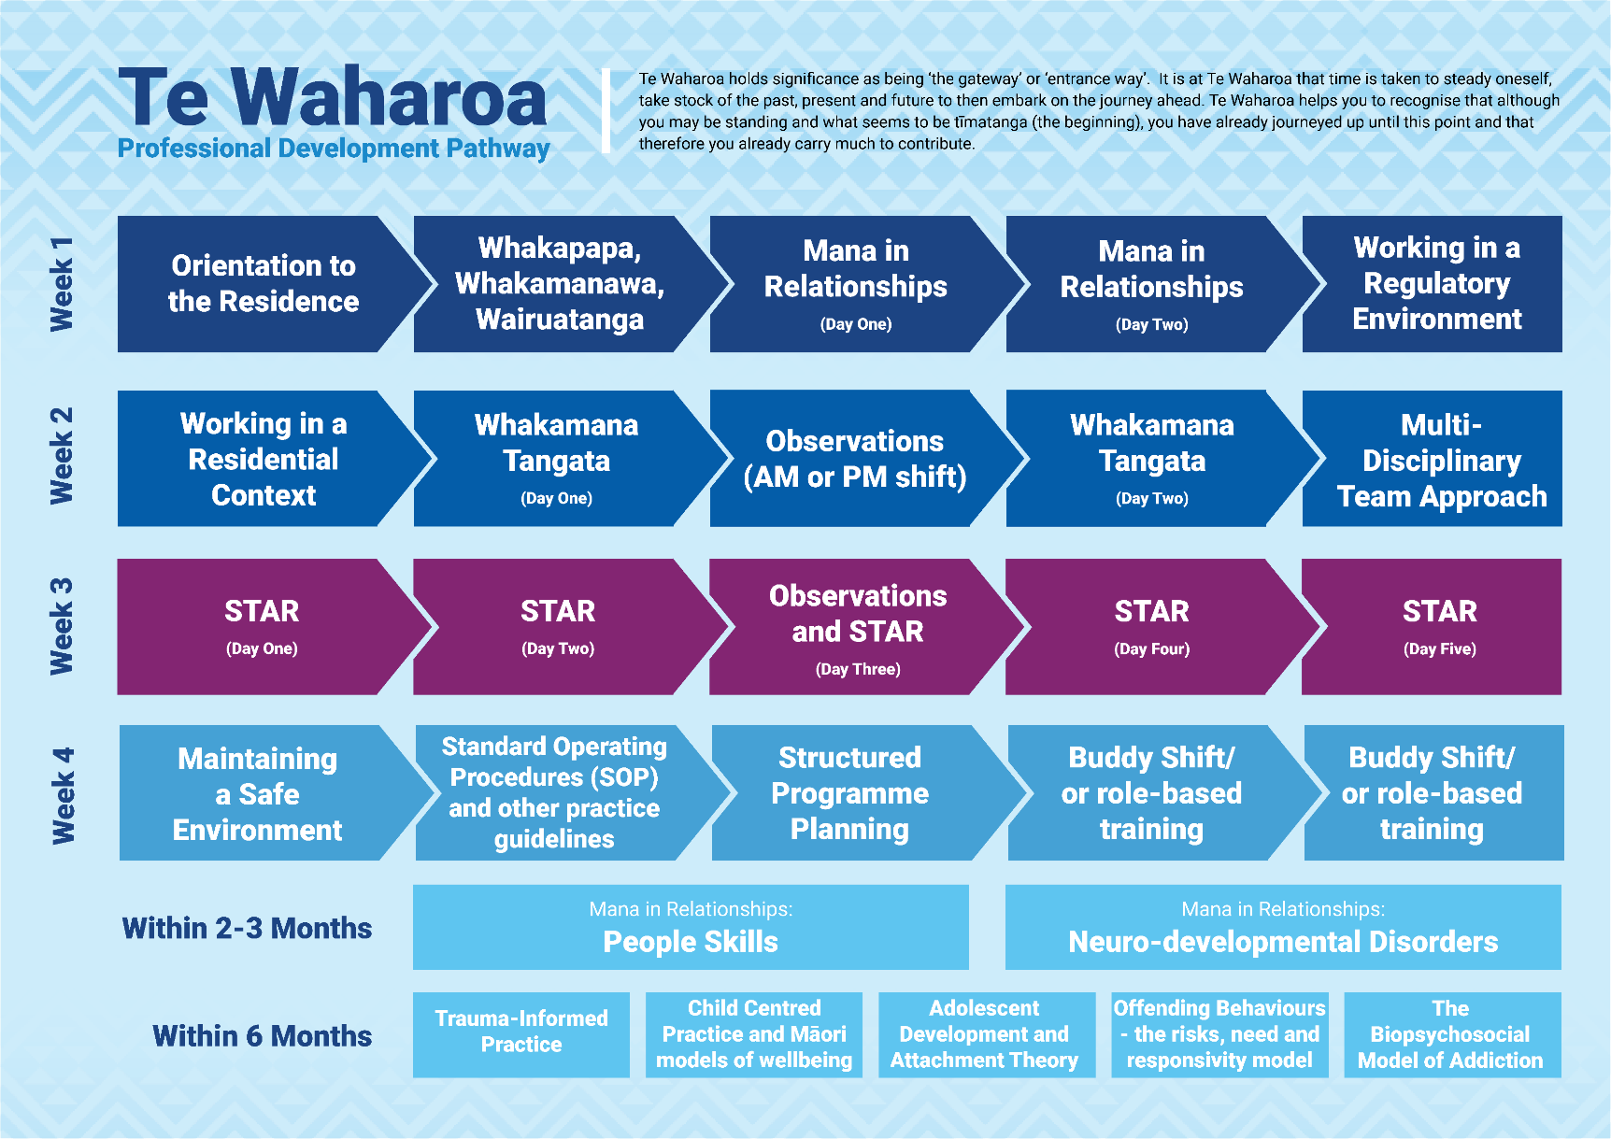
Learning Journey
Safe Tactical Approach and Response (STAR) training is delivered across five days as part of the Te Waharoa Induction.
It is broken up into two parts over the first four days with the following content:
Theoretical training in the morning session
Defensive tactics and techniques in the afternoon session
The final day concludes with a review of the content, participant roleplays and assessments (on both theoretical knowledge and practical application of defensive tactics and techniques.

Slide 4


Structure of STAR
1
Day One
2
Day Two
3
Day Three
4
Day Four
5
Day Five
Theory
Introduction and overview
Residential Safety Framework and connection with Whakamana Tangata
Values revisited
Prosocial modelling
Conscious and unconscious bias
Legislation
Governing bodies and the media
Theory
Power and responsibility
Professional Practice
Risk-based decision making
Theory
Observation Shift
Incident Report Writing Responding to an incident
The A-B-C Model for incident report writing
Incident report writing practice
SOSHI & Serious Event Notification (SEN)
Theory
Trauma responses – cause and effect
Linking Maslow’s Hierarchy of Needs, Te Whare Tapa Whā and the Residential Safety Framework
Verbal de-escalation techniques
Assessment
Theory test
Participant presentations of skills learnt over the week
Drills
Physical
Revision of principles of safety, principles of engagement and engagement techniques
Safe ground holds
Staff protection on the ground
Room exits
Recovery – staff debrief
Restoring mana - hue whakapiri
Physical
Principles of Safety
Disengagement Techniques
All aspects built into some low-level scenarios to apply the relative skills in correct context.
Physical
Revision of Principles of Safety and Disengagement Techniques
Principles of engagement
Engagement Techniques
Full Day
Full Day
Full Day
Full Day
Full Day

Slide 5

Learning Outcomes
By the end of this training kaimahi will be able to:
Describe the residential safety framework and its practical application in the residences along with the legal and regulatory boundaries they work in.
Understand their own internal and external stress triggers and various techniques for managing them
Demonstrate the importance AWOCA as verbal de-escalation techniques
Describe the TENR process and application for responding to incidents
Attain basic proficiency in the application of tactics and techniques requiring use of the physical component of STAR

Slide 6
Training topics – in more detail
Theory
After giving the learners and overview of what to expect from the STAR training, we will begin by introducing the Residential Safety Framework and its connection with Whakamana Tangata. It is important to emphasis STAR is not just a restraint and control programme. STAR sits within a holistic safety framework and links theory and practice using evidence based and restorative practice. We will revisit the Oranga Tamariki values and Whakamana Tangata whetū, exploring how they work together and can be applied to managing challenging behaviour. Prosocial Modelling will cover off what it is (and isn’t) as well as how to practice it ensuring that cultural considerations are taken into account. Conscious & Unconscious Bias will be revisited, explicitly to link these with how they relate to challenging behaviour. The legislation section of the training reviews how the legislation defines self-defence and what use of force is defendable - and the implications of this for residential practice.
Physical
Principles of Safety: Safe Stance Red zone/Green zone (RZ/GZ) Contact and cover Shelling inside red zone Disengagement techniques: Redirection Train Stop Shelling and exit RZ GZ All aspects built into some low-level scenarios to apply the relative skills in correct context.
1
Day One
Theory
Introduction and overview
Residential Safety Framework and connection with Whakamana Tangata
Values revisited
Prosocial modelling
Conscious and unconscious bias
Legislation
Governing bodies and the media
Physical
Principles of Safety
Disengagement Techniques
All aspects built into some low-level scenarios to apply the relative skills in correct context.
Full Day

Slide 7
Training topics – in more detail
Theory
We will discuss the power and responsibility dynamic that exists within the learner's role, revisiting personal power vs. positional power (contextualized with activities with incident scenarios). This section will also address the potential for abuse of power/punitive practice. Professional Practice will address that all actions taken by staff are to make safe, and never with intent to harm or punish. We will cover rational detachment, knowing your triggers and using your team, making the call, and backing each other up. In risk-based decision making we will revisit the decision-making framework, introduce the T.E.N.R model, the Tactical Options toolbox and A.W.O.C.A. We will also revisit assessing risk behaviours and decision making, and Whakamana Tangata interventions.
Physical
Brief revision of Principles of safety Disengagement techniques Principles of engagement Contact and cover (straight on vs. safe angle) Always Shell when entering Red Zone Minimal time in Red Zone Engagement Techniques Shoulder to shoulder entry Off balancing and centre of gravity Maintaining contact Underhook control drill (importance of the underhook) Rear body lock arm drag Cross grip and cross grip figure four Transport hold (front and back) Figure four classroom model Figure four entries and applications Discussion around safety of figure four
2
Day Two
Theory
Power and responsibility
Professional Practice
Risk-based decision making
Physical
Revision of Principles of Safety and Disengagement Techniques
Principles of engagement
Engagement Techniques
Full Day

Slide 8
Training topics – in more detail
Theory
The learners will complete observations in units (AM or PM Shifts). Incident report writing will begin by introducing the what and the why of incident reporting, including who our audience is. In responding to an incident, we will look at T.E.N.R, Whakamana Tangata interventions & A.W.O.C.A and review the legislation to support us in how to articulate it in an Incident Report. We will look at the A-B-C Model for Incident Report Writing and how to structure an Incident Report using A-B-C. Examples and templates will be provided to support this. There will be practical application of the learning through reviewing an incident video and completing an Incident Report for the scenario. Learners will be taken through how to complete a SOSHI and Serious Event Notifications (SEN).
3
Day Three
Theory
Observation Shift
Incident Report Writing Responding to an incident
The A-B-C Model for incident report writing
Incident report writing practice
SOSHI & Serious Event Notification (SEN)
Full Day

Slide 9
Training topics – in more detail
Theory
Day four begins by looking at Trauma Responses – Cause & Effect. We’ll look at linking the learning from Mana in Relationships (Te Waharoa) to managing challenging behaviours. We’ll address the triggers of trauma responses, as well as trauma and the brain, (Fight, Flight, Freeze Response). We will link Maslow’s hierarchy of needs, Te Whare Tapa Whā & The Residential Safety Framework together in the response to trauma. Learners will also be introduced to verbal de-escalation techniques, bringing in learning around understanding aggression, people skills, and linking the Social Discipline Window and the Three Pillars to Trauma Informed Practice and the Residence Safety Framework. This will include opportunities to practice verbal de-escalation in roleplays.
Physical
Review of: Principles of Safety Principles of engagement Engagement Techniques covered in day two Ground Techniques Discussion – on restraints and the ground - Positional Asphyxia and safety in Ground holds Safe ground holds Shoulder to shoulder pressure principle Shoulder to shoulder face down holds Shoulder to Shoulder face up hold Risks on the ground (approach) Getting back to feet (approach and troubleshooting) Staff protection on the Ground 12-6 Principle Technical/Safe Stand up Room Exits Standing, kneeling and lying Recovery and restoring mana – Staff debrief and Hue Whakapiri
4
Day Four
Theory
Trauma responses – cause and effect
Linking Maslow’s Hierarchy of Needs, Te Whare Tapa Whā and the Residential Safety Framework
Verbal de-escalation techniques
Physical
Revision of principles of safety, principles of engagement and engagement techniques
Safe ground holds
Staff protection on the ground
Room exits
Recovery – staff debrief
Restoring mana - hue whakapiri
Full Day

Slide 10
Training topics – in more detail
Assessment
The final day of the training is reserved for assessment of the learners. This is done on both a theory and practical level. The learners will complete a Theory Test before taking part in a presentation (10-15min) of what they have learnt over the week including demonstration of holds. They will complete a set of drills – for example: participants are given keys/radios and then allocated to different areas of the residence. When they hear “STAR participants to……” they must respond to the area as if they are the response team – STAR instructors to stage an incident.
5
Day Five
Assessment
Theory test
Participant presentations of skills learnt over the week
Drills
Full Day

