Slide 1
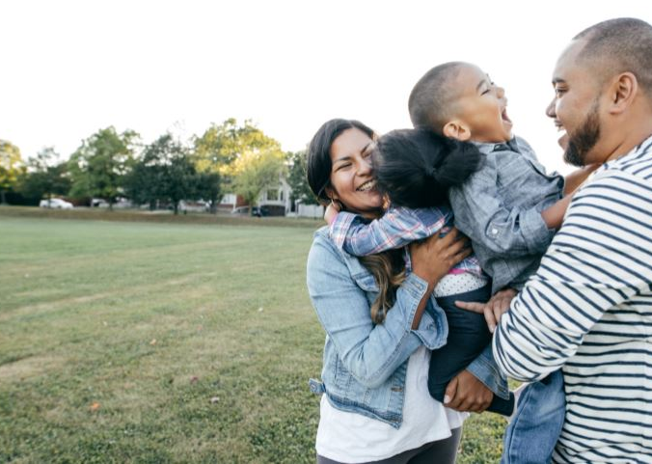
Purpose and Vision
Integrated Primary Mental Health and Addictions Model
A primary health and wellbeing system that is more accessible, engaging, connected, delivered by people who are personally and professionally motivated, and gives every New Zealander their right to live well
Notes:
Selwyn Leaf – Team Lead and Health Coach from Avondale Medical Centre
Sisileti – Health Coach for Otara Mall and Special Projects
Miren – Health Coach for Wai Health and Youth Self-Management Groups
Tamaki Health aka Local Doctors
Patti Robinson, Leona Dibsbury

Slide 2
The model for an Aotearoa context
Community based
Self-determining
No referral criteria
Warm handovers
Free support for person accessing
Culturally Competent Workforce
Focus on Māori, Pacific and Youth
Whole-of-person wellbeing focused
Notes:
Explain the important points of the model and how it differs from traditional primary care to address New Zealand's health needs
Community based - Integrate into the community through
Self-determining - Offer choices related to time, location, decisions about treatments and options for the whaiora
No referral criteria - Unlike previous services where there is often a criteria for further support/treatment such as a certain level of mental distress or health markers of a certain seriousness, this project is open to everyone at every stage of theirs and their whanau’s health journey starting in primary care
Warm handovers - Appointments not needed—see someone for mental and physical health support on the day in their primary care clinic for free
Free support for person accessing - No extra cost and no limit of number of interactions—very different to previous access to auxiliary services
Culturally Competent Workforce- The goal is to increase cultural competence for working with Maori Pacific and youth by: 1) supporting staff who are culturally competent to train and work in the new roles, offering support and courses to those taking up the new roles and also to existing staff, working closely with NGOO’s and local community support to connect those who are already there to support
Focus on Māori, Pacific and Youth - Much work is being done and will continue to increase understanding, communication and address barriers
Whole-of-person wellbeing focused - Both a mental health and physical health focus with emphasis on whanau and community---none of us stand alone.
What are we trying to make different:
Tino Rangatiratanga: Self determination
Support to make decisions about my health and care and desired level of support—knowing that I can choose and that there are always options
Taura Here : The link between
Have someone who takes the time to help me to link with medical and community services in a comfortable way
He Kaiaarahi: A guide
Help to navigate the multiple services and community supports available for me and my family
Tiaki Taauhu: Ongoing Care
Someone I can check in with over time even if my services and clinicians vary
Manaakitanga : A state of caring
In the midst of health challenges and complex health instructions and tasks, know that there is care and person to person support for me and my family…Also that they will be cared for if they do feel comfortable/brave enough to seek help

Slide 3
The aim of these new services is to:
Increase access and equity of access
Increase choice in addressing people’s holistic concerns
Reduce wait times for mental health and addictions support
Improve population health and equity outcome
Notes:
Emphasizing the key aims to improve primary health
You are now part of an idealistic and potentially groundbreaking adventure!
Improving access to medical care and support includes addresses equity issues. Making healthcare more accessible has been a goal for many years and is more important now than ever…
once access is gained, offering choices related to a persons overall situation, concerns and needs connects them to support they are seeking in order to make room for medical support required
With the role of the HIP and Health coach whaiora can be seen on the day and connected to support within the clinic with the goal of gaining connection to support when needed-not to long waits on waiting lists
The goal is equity of access to health for all in new Zealand
What are we trying to make different:
Tino Rangatiratanga: Self determination
Support to make decisions about my health and care and desired level of support—knowing that I can choose and that there are always options
Taura Here : The link between
Have someone who takes the time to help me to link with medical and community services in a comfortable way
He Kaiaarahi: A guide
Help to navigate the multiple services and community supports available for me and my family
Tiaki Taauhu: Ongoing Care
Someone I can check in with over time even if my services and clinicians vary
Manaakitanga : A state of caring
In the midst of health challenges and complex health instructions and tasks, know that there is care and person to person support for me and my family…Also that they will be cared for if they do feel comfortable/brave enough to seek help

Slide 4
BHC-HIP
Health
Improvement
Practitioner
HC
Health
Coach
CSW
Community
Support
Worker
Integrated Model
Notes:
HIP or Wellness Advisor (Tamaki Health Name)
Generalist – supports not only with primary health concerns but also with determinants of health
Based in FACT/ACT Acceptance and Commitment Therapy
Clinical, background in OT (Occupational Therapist), Psychology, Therapist, Social Workers.
Awhi Ora or Community Support Worker
Awhi Ora in Auckland
Helps with walk along-side support
Connects with support in the community, WINZ, Housing, Food.
Health Coach

Slide 5
Gather
Generalist
Accessible
Team based
High productivity
Educator
Routine pathways

Slide 6
Building Peer Support Programs to Manage Chronic disease: Seven Models for Success
Group Appointments
Self-Management
Support Groups
Phone support
Online Support
Health Coaching
Peer Support
Wheel of Support:
Seven types of peer support

Slide 7
Heals
Helps
Enables
Available
Links
Support

