Slide 1
Health System Workforce

Slide 2
Background
Collaborative, integrated and coherent approach to workforce
    Te Aka Whai Ora - Māori Health Authority
    Te Whatu Ora - Health New Zealand
    Manatū Hauora – Ministry of Health
The workforce programme is whole of health system, integrated with the wider social care system
A clear strategic intent with short and longer term initiatives to address significant workforce pressures
Single workforce team in Te Whatu Ora and establishment of the Workforce Taskforce
Joint leadership – Ailsa Claire, Te Whatu Ora and Anna-Marie Ruhe, Te Aka Whai Ora
Collaboration – Pauline Sanders, Te Whatu Ora Pacific Health
Notes:
Te Whatu Ora - Health New Zealand and Te Aka Whai Ora - the Māori Health Authority are working together on initiatives to address significant workforce pressures and to deliver a simpler, more equitable and coordinated health system.
The Workforce Taskforce has been established to address significant workforce pressures across the health system, focusing both on immediate priorities and a longer-term plan to build a sustainable workforce able to meet future challenges.
Te Whatu Ora and Te Aka Whai Ora are working in partnership on the Taskforce, underpinned by the commitment to improve equity and Māori outcomes, and embed Te Tiriti ways of working.
It is jointly led by myself, and Anna-Marie Ruhe, Workforce Lead from Te Aka Whai Ora.

Slide 3
Equity and Te Tiriti
Model a Māori partnership approach
Ensure equity and Te Tiriti are central to all Taskforce activities
Ensure clear alignment between Taskforce activities and medium to long-term work planning by Te Whatu Ora and Te Aka Whai Ora
“What’s good for Māori is good for everyone”

Slide 4
Overarching Programme Principles
Whakamaua: Māori Health Action Plan 2020-2025 and Te Tiriti o Waitangi principles
Te Tiriti o Waitangi principles | Tino Rangatiratanga | Are we actively enabling and advocating for Māori self-determination and mana motuhake in the design, delivery and monitoring of workforce activity and initiatives?
 | Equity | Are we actively enabling and advocating for equitable access for Māori to workforce programmes and initiatives?
 | Active Protection | Are we demonstrating the dedicated effort required to achieve Māori Health equity through increasing Māori within the workforce?
 | Options | Are we actively enabling and advocating for Kaupapa Māori Services Workforce needs and hauora Māori models of understanding in our activities and initiatives?
 | Partnerships | Are we actively enabling and advocating for partnership with Māori with the governance, design, delivery and monitoring of Workforce activity and initiatives?
Whakamaua: Māori Health Action Plan 2020-2025 and Māori Health & Disability Workforce
Priority 2 (Whakamaua) Increase Māori decision-making throughout the Health and disability system’s leadership and governance arrangements. |  |  | Reflective question for leads, members and its workstreams to utilise: Will this (idea or decision) enable more Māori to participate in leadership and decision-making opportunities?
Priority 3 (Whakamaua) Develop a Māori Health and disability Workforce that reflects the Māori population, Māori values and Māori models of practice. |  |  | Reflective question for leads, members and its workstreams to utilise: Will this (idea or decision) enable the reflection of the Māori population, Māori values and Māori models of practice within the profession?
Notes:
Te Whatu Ora - Health New Zealand and Te Aka Whai Ora - the Māori Health Authority are working together on initiatives to address significant workforce pressures and to deliver a simpler, more equitable and coordinated health system.
The Workforce Taskforce has been established to address significant workforce pressures across the health system, focusing both on immediate priorities and a longer-term plan to build a sustainable workforce able to meet future challenges.
Te Whatu Ora and Te Aka Whai Ora are working in partnership on the Taskforce, underpinned by the commitment to improve equity and Māori outcomes, and embed Te Tiriti ways of working.
It is jointly led by myself, and Anna-Marie Ruhe, Workforce Lead from Te Aka Whai Ora.

Slide 5
Workforce Strategy
Led by Manatū Hauora – the Ministry of Health
    Strategic Framework – Dec 2022
    Health Workforce Strategy - 2023
Broad engagement
    Roadshows
    Webinars (3 agencies)
    Health workforce dialogue event
On-line Engagement Tool – Tatou
    https://tatou.health.govt.nz

Slide 6
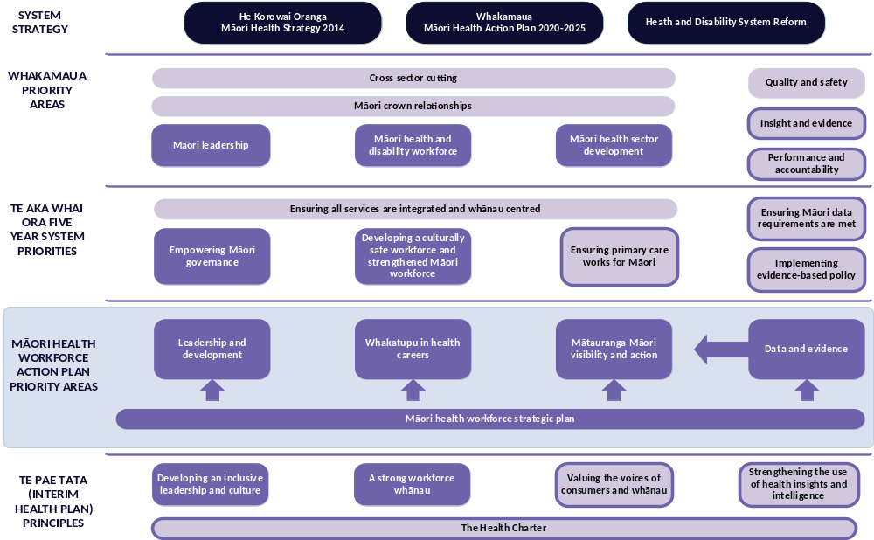
Notes:
2 year work progamme
Examples Leadership & Development- increase support to management & leadership pathways
Whakatupu in Health Careers- Increasing the no. of maori studying,graduating,entering, and remaining in health careers - thru access to mentoring/coaching programes -earn as you learn, growing priority workforce areas, enhancing the kaiawhina role and increase access to microcredentialling pathways,
Mātauranga Māori visibility and action- growing Rongoa & traditional hauora roles, support iwi centric workforce solutions
Data & Evidence- consistent iwi and data protocols, Kaupapa māori evaluation and research approaches

Slide 7
Our partnership approach
A shared way of working which reflects a Te Ao Māori approach
Kaupapa Māori / mātauranga Māori approaches ensure meaningful engagement with our wider partners and communities
Informed by quality data and evidence
Supports achievement of key priority areas for Māori health workforce development and growth
Direct
commissioning
Increased investment in Māori specific education and training programmes
Training and education provided across all levels of workforce, delivered regionally and nationally
Commissioned directly by Te Aka Whai Ora
Co-commissioning
Targeting Māori workforce development and growth across education and training programmes
Includes focus on key workforce priority areas
Co-commissioned with Te Whatu Ora partners
Partnership
Partnering with tertiary education providers and cross-government agencies and stakeholders
Focus on targeting Māori workforce development and growth
Growing and scaling successful Māori models of education and training pathways
Workforce Taskforce Working Groups

Slide 8




Vision
Pacific Health Workforce Team
Te Whatu Ora:
Pae Ora
Healthy Futures
Pacific Peoples:
Confident, thriving, resilient and prosperous Pacific Aotearoa
Lalanga Fou Goals
Thriving Pacific Languages, Cultures, and Identities
Prosperous Pacific Communities
DEVELOP
Pacific Health Workforce Action Plan
INFLUENCE
Models of Care & Initiatives
Confident, Thriving and Resilient Young People
Resilient and Healthy Pacific Peoples
Ola Manuia
Pacific workforce are valued, supported and reflective of Pacific Aotearoa
INVEST
Initiatives to Strengthen & Transform
DELIVER
Ola Manuia action in Te Pae Tata
Levers for change
Pacific enabling Policies
Integrated Pacific Models of Care
Trusted Strategic Relationships
Equitable Pacific workforce resourcing
Accurate Pacific workforce data
Equity for Pacific
Pacific Health Priorities
Mothers & babies
Children & youth
Older People
Pandemic Response
People with disabilities
Long-term conditions(cancer, gout, diabetes)
Mental health & well being

Slide 9
Pacific Health Workforce Timeline
Sep – Oct 2022
Oct – Nov 2022
Nov – Dec 2022
Draft National Workforce Action Plan
Map workforce pipeline
Dec – Jan
2023
National Workforce Action Plan
Feb – Mar
2023
Appoint Interim Workforce Lead
Appoint Interim Programme Manager Workforce
Understand Structure
Understand existing state
Manage / review existing funding and contracts
Consolidate programme of work
Mar – Dec
2023
Prioritisation of workforce actions
National workforce datasets & forecasting
Te Pae Tata, Ola Manuia alignment
Sector engagement
National Pacific Health Senate establishment
Ongoing sector engagement
Monitor and evaluate
Deliver agreed prioritised actions
Workforce Planning
Workforce Implementation
  Workforce Plan implementation
  Monitor and evaluate
9

Slide 10
Nature of Work
ŪPOKO| HEAD | RINGA | HANDS | NGĀKAU | HEART
Te Titiri is central to our mahi – ‘what works for Māori will likely work for everyone’ Our work models deliver wellbeing, flexibility and satisfaction of employment Appropriate number of skilled workers to meet population needs and safe staffing Our people are and feel well-led Adaptable mindsets and careers are supported, developed and enabled Autonomy is as close to patients as possible | Cultural safety and addressing unconscious bias interwoven in every education and training experience Training is flexible, modular and includes micro-credentialling Prior learning and life experience has assessment value Learning methodology and core structures enable rapid creation of suitable workforce Earn and learn is a valued and viable pathway for workforce training | Employees who live, work in and support their own communities are supported to develop and remain serving their communities Health workers are confident to think and act beyond traditional care models The health outcomes communities and whānau want are honored Māori aspirations and philosophies are valued Cultural worldviews are recognized and integrated into care It’s an honour to teach and placement is a mana-enhancing experience

Slide 11
Taskforce structure overview
Chief Executives
Te Whatu Ora & Te Aka Whai Ora
Planned Care Taskforce
Immunisation Taskforce
Workforce Taskforce
Chair – Ailsa Claire (OBE)
Co-chair – Anna-Marie Ruhe
Workforce Working Groups
Nursing
Midwifery
Medical
Kaiāwhina
Allied Health, Technical & Scientific
Administration & general management
Taskforce and working groups underpinned by the Māori Workforce and Pacific Workforce Action Plans.

Slide 12
Members of the Taskforce
Ailsa Claire - Taskforce Chair/ Interim Workforce Lead, Te Whatu Ora
Anna-Marie Ruhe - Taskforce Chair/Interim Workforce Commissioning Lead, Te Aka Whai Ora
Abbe Anderson - National Commissioner, Te Whatu Ora
Andrew Slater - National Director Innovation, Te Whatu Ora
Dr Jason Tuhoe - General Practitioner
Fiona Michel - Chief Executive Officer, Braemar Hospital
Fionnagh Dougan - National Director, Hospital & Specialist Services, Te Whatu Ora
Gillian Dudgeon - Deputy Chief Executive, Delivery, Tertiary Education Commission
Kate Clapperton-Rees - New Zealand Council of Trade Unions (NZCTU)
Mara Andrews - Deputy Chief Executive, Service Development and Relations, Te Aka Whai Ora
Markerita (Meg) Poutasi - National Director, Pacific Health, Te Whatu Ora
Mairi Lucas - New Zealand Council of Trade Unions (NZCTU)
Professor Joanne Baxter - Dean, Dunedin School of Medicine, University of Otago
Sonia Hawea - Chief Executive Officer, Taikura Trust
Taima Campbell - Manukura Hauora - Te Puna Hauora Matua o Hauraki.

Slide 13
Kaiāwhina
Principles
Vision
Whanau centred approach underpinned by cultural models of care
Te Tiriti is embedded and upheld
Model a partnership approach with key stakeholders
Equity enabling
Iwi and community led co-design
Engagement, joined up and collaborative
recognise and valuing potential, support and enable people to thrive and grow
Continuous improvement model
Whanau and communities will achieve Pae Ora/Ola Manuia
Through building and developing capability within
whanau and communities
By growing, valuing and retaining the kaiāwhina workforce
Future State
Plan to December 2022
Planned and strategic approach to developing Kaiāwhina pathways
Community knowledge increases and connectivity with the health system through the Kaiāwhina role
Flexible learning models that attract more people into these roles
  Earn and learn
  Multi-channel learning modalities
  Ability to train in rural areas
More opportunities for disabled people | tāngata whaikaha to thrive in Kaiāwhina roles
  The Kaiāwhina role is recognised and valued
  People are proud to work in the Kaiāwhina area
Establish the Kaiāwhina Workforce Working Group
Service agreement in place with Toitu Te Wairoa to ensure prioritization
of micro-credentialling
Work programme agreed and implemented.
Priority areas:
  Vaccinator health workforce development
  Micro-credentialling
  Oral health
  Health Care Assistants ‘Earn as you learn’ model
Sector engagement model developed
Initial update to the sector

Slide 14
Further potential for Micro credentialling
Roles to support registered professions working top of scope
Pathways to registration
Recognition of existing training programmes
Flexible scopes of practice
Notes:
Definition:A micro-credential is an award that is not a qualification
listed on the Qualifications and Credentials Framework
delivered by registered tertiary education providers
can be up to 40 credits in size and at any level of the framework

Slide 15
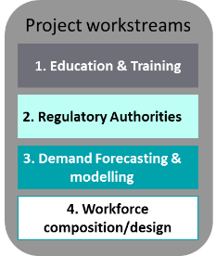

Allied Health, Technical & Scientific
Strategic challenges
High workforce pressure (vacancies, fatigue, attrition)
Difficult training pathway(s) with limitations for entry + high clinical placement training hours required
Poor representation of Maori & Pacific people in the workforce
Unable to work at top of scope due to stretched resource
Workforce required for planned care restore & reset
Changing models of care
Additional FTE required to accommodate supervision for trainees – currently not budgeted
Out of scope: FTE, Remuneration & Reward
Priority Areas
Cardiac Sonographers
Cardiac Physiologists
Strategic Workforce ‘pipeline’ audit
Oral Health Therapists
Anaesthetic Technicians
Physiotherapists
Occupational Therapists
Desired Outcomes & actions
Te Tiriti partnership & Whakamaua priorities throughout
NZ-based training programmes/sustainable programmes available
Training programmes suitable for Maori & Pacific trainees
Implementation of micro-credentialing
Ability for AH S&T to work at top of scope to best support community
Psychologists
Pharmacists
Paramedics

Slide 16
Overview of initiatives
International Recruitment Centre
International recruitment campaign and ethical recruitment approaches
Immigration support
Registration fast track
Return to Nursing Workforce Fund​
Return to Midwifery Workforce Fund
Real Nurses campaign
Expanding the
Nurse Practitioners programme
Internationally Qualified Nurses CAP Fund
Postgraduate Diploma for Pacific trained Nurses
NZREX bridging programme
NZREX General Practice Pathway
General Practice Education
Programme
Rural Locum Scheme
GP and Public Health Doctors
Radiology Registrar training placements
Notes:
NZ REX = New Zealand Registration Examination
International Recruitment Centre starts late Oct
Recruitment Campaign​ starts mid Nov

Slide 17
Working with TEC and Education providers
Single point of connection/governance
Understand the workforce pipeline
Evaluation on training
Common curriculum
Modular training possibilities
Micro-credentialling
Training placements centrally coordinated

Slide 18

Future initiatives
Earn-as-you-learn, scholarships, grants, apprenticeships, internships, financial support for Māori and Pacific students
Entry-to-health jobs, schools, tertiary providers, life-long learning and development
Flexible career pathways, micro-credentialling and modular training
Cultural Safety
Early in career development and support
Review of regulatory framework and role of colleges (Ministry of Health)
Whole system training settings
Partnerships, including MSD, Corrections, ACC
Prioritisation Framework

Slide 19
Working
Together
for
Success

