Slide 1






SKILLS
GROUP
Bringing ROVE to Life

Slide 2

Creating
A New Future
For Skills
We have taken where we came from (30 years of training within the Industry) and started integrating that with what we have acquired (4 PTEs).
The strategy behind the integration is:
Bringing Rove to Life
A journey has started within Skills, in which we will be agnostic about where a learner engages with us. We will have created options that suit the individual learner’s needs.
skillsconsultinggroup.com

Slide 3








KEY TENETS OF OUR STRATEGY
Learner Centric
World-Class Vocational Training
Agnostic to “place” of study
Supporting Regional Needs
Industry Led
Focused on Priority Sectors
National Coverage
Partnership Model for Iwi & Large Businesses

Slide 4
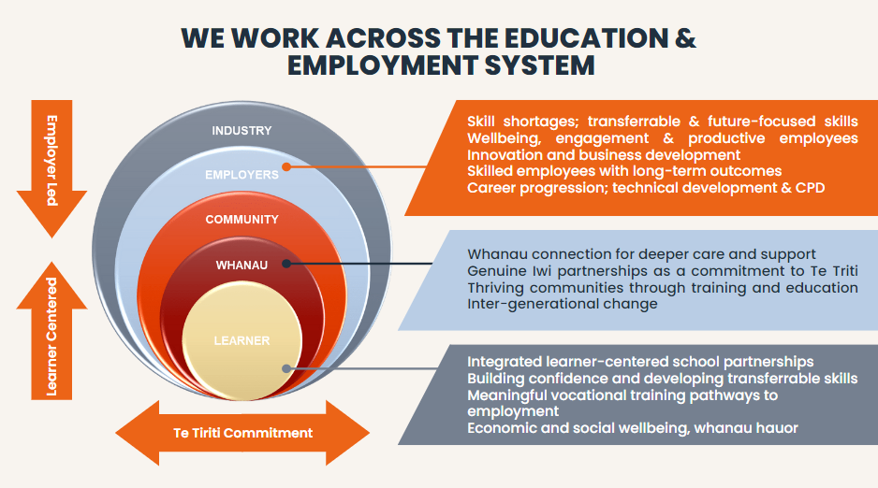
Since we last met, we have been actively engaging
with our stakeholders and perfecting our partnerships.
Partnering and connecting across “transitions” is our superpower
Presbyterian Support
Te Hiku
MSD
Idea services
Kenderdine Park
Kerringle Park
Spectrum Care
Health Vision
Real living
Real World Living
Pukekohe Possum Bourse
Whatever it Takes
Logan Campbell/ Ryman Health
Enliven
Attainable Trust
St Patrick Rest Home
Awanui Rest Home
Papakura Private Hospital
Blockhouse Bay Rest home
Raukura Hou Ora
NZ Health Care
Ambridge Rose Manor Pakuranga

Slide 5
1.
Campus based learning that is based on innovative industry practices that prepare workforces for the future
2.
Vocational industry pathways to enable learners to build confidence, work readiness, and pathway into meaningful employment.
We have Several Fundamental Pathways that Bring ROVE to Life
3.
Work Integration “Cadetship” Programme
Co-developed with and for Employers
4.
Learning in the Workplace - Work based Pathway
skillsconsultinggroup.com
5.
Apprenticeship Industry Pathways

Slide 6
1.
Campus based learning that is based on innovative industry practices that prepare workforces for the future
Soft skill development & strong academic foundations
Industry led innovative teaching and content
Ongoing research & innovation to inform programme development
Learners
School leavers Career changers Second chance education
Work readiness
ROVE Benefits
Preparing learners to enter industry with relevant and leading edge skills Academic quality and excellence Industry led, future skill development to address critical industry shortages and technologies Pathways into research and best practice Soft skill development – learning how to learn, critical thinking etc
Learner
Industry Tutors
Quality Teaching & Support

Slide 7

2.
Vocational Industry Pathways to enable learners to build confidence, and work readiness and to pathway into meaningful employment.
Learners
School leavers Second chance education 16-24 yrs
Kaitiaki (Learner Pastoral Care) + TextPulse
Nesian Waka Programme
SOFT SKILLS
WORK-READY
WELLBEING “HAUORA”
ROVE Benefits
  Critical Thinking
  Problem Solving
  Team Work
  Communication
  Self Leadership & Resilience
  H/S & Onboarding
  Digital, Literacy & Numeracy
  Team Work
  Collaboration
  Self-esteem & Social
  Health & Confidence
  Mental & Emotional
  Spiritual
A pipeline of talent for employers Early engagement with schools Pastoral care – wellbeing & learning MSD and LSV opportunities to Pathway Community and school led A provision in priority areas Primary area of focus, priority learners who do not always have a clear pathway into further training or employment
Industry Specific & Context
1) Internship opportunity OR
2) Brokerage into Work Integration OR
3) Pathway into further study

Slide 8
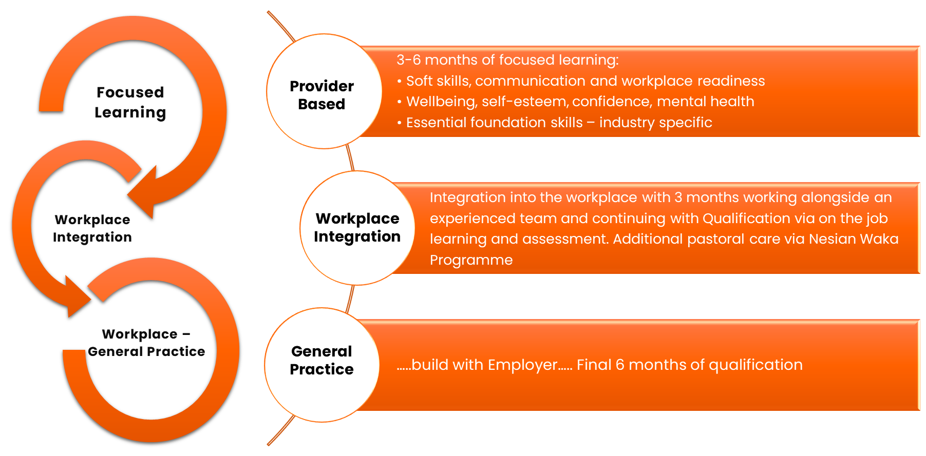
Work Integration “Cadetship” Programme
3.
Programme Co-developed with and for Employers

Slide 9
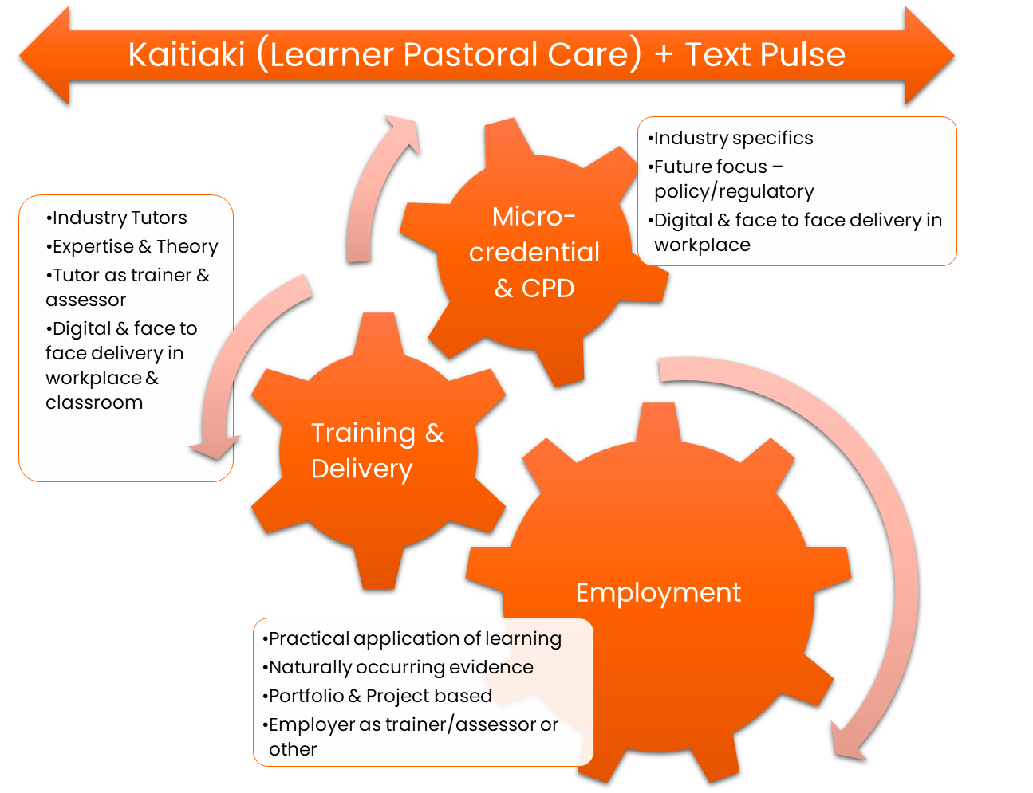
4.
Learning in the Workplace - Work based Pathway
Learners
Career changers School leavers Employees
ROVE Benefits
Upskilling of the existing workforce & retention Commitment from the employer for ongoing development for employee Delivery options blended Pathways for learners that lead to improved economic and social wellbeing

Slide 10
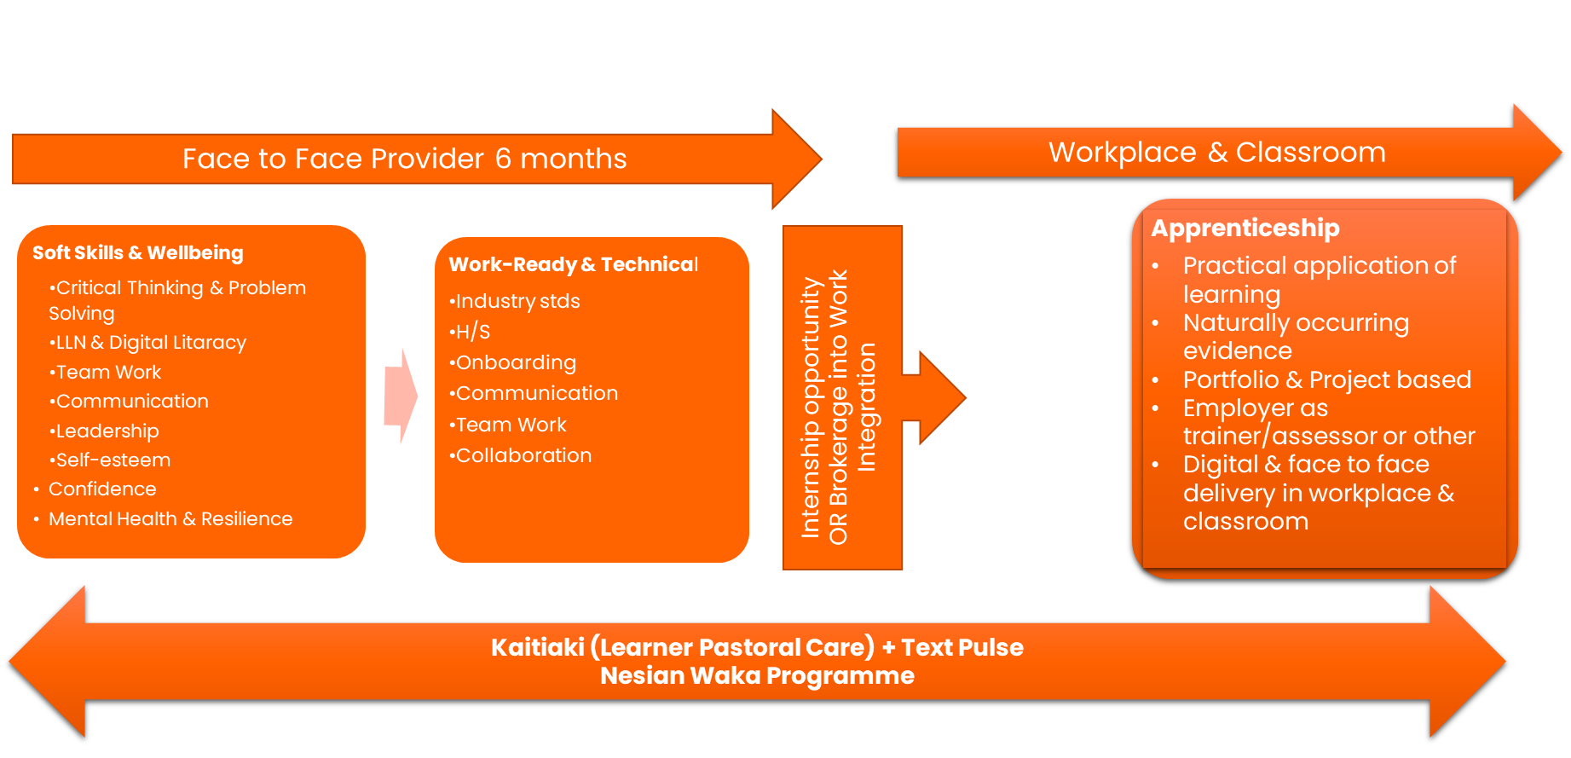
5.
Apprenticeship Industry Pathways
Pre-trade Level 3
Level 4 Apprenticeship
Learners
ROVE Benefits
School leavers Second chance learners 16-24 yrs
Pipeline of talent for employers & skill shortages Early engagement with schools Pastoral care from classroom into work – wellbeing & learning
School & employer led National Provision, with a regional focus to meet demand – Auckland, Wellington & Dunedin
Industry engagement and support Innovation and mobile labs to address some of the provision challenges

Slide 11
We are applying our holistic and evidence-based approach to Pastoral Care and Hauora at critical transition points
Our Nesian Waka Programme
TextPulse
  Inspires Māori and Pacific people to illuminate and ignite their pathway to success through education, training and employment.
  Nesian Waka sets sail to inspire the young minds of our future generation, illuminate a pathway in discovering new learning opportunities, that will ignite future success.
  Encompassing Tikanga Māori and Pacific values, this journey will be navigated with a village focus and warm awhi into our Skills whanau. Through partnership, we aim to build strong, resilient and prosperous Māori and Pacific peoples and grow our influence in the community.
  Our Nesian waka navigators support the onboarding of individuals as they embark on their journeys through education and employment. Our navigators support, build ambition, and help map ou this journey to ensure key milestones are met and celebrated along their journey.
  TextPulse is an evidence-based virtual wellbeing system that uses two-way text messaging, backed up by artificial intelligence and one-on-one human interaction with Wellbeing Angels.
  By proactively checking in with individuals, rather than waiting for them to show signs of stress, TextPulse identifies learners who are struggling before their challenges have a serious impact on their life and mental health.
  TextPulse is a simple, easy-to-use method of making employees feel safe and supported in sharing their challenges and demonstrating your genuine care for their wellbeing as their employer.
  TextPulse is the result of a partnership between Skills Consulting Group and global award-winning digital health organization WelTel Health Inc.
  15 years - of pandemic, clinical and wellbeing deployments;
  75+ peer-reviewed publications, including Lancet, BMJ, NEJM, and Nature;
  7000+ citations by other researchers;
  ~100 featured in business magazines and new stories, including CNN Money, The Economist, The New Yorker, MIT Tech. Review, Fortune Magazine, CBC.

Slide 12


Through our partnering and research,
we know that there are key areas that
are being underserved
Health and Aged Care
Kaiāwhina Workforce
skillsconsultinggroup.com

Slide 13
Health & Aged Care
Opportunities for Skills Group to support
  Developing the health workforce is everywhere in the RSLG plans, with detailed mentions in 13 of 15 RSLG workforce plans.
  Northland, Auckland, Waikato, BOP, Manawatū-Whanganui, Wellington, Marlborough, Canterbury, Otago
  Aged Care also features across RSLG plans and insight reports, as an area of worker shortage, and specifically named as a priority industry by Northland, Wellington, West Coast, and Southland. Major undersupply in training, with over 75% happening in only 3 out of the 15 regions (Auckland, Canterbury, Waikato).
  Concerned about Māori underrepresentation in the heath and aged care workforce.
  Wellington, BOP and Manawatu high demand, with no training supply
  No teaching or learning delivery with the Careerforce training, as a 100% on-job model, with entirely workplace-led assessment.
  It seems very unlikely that the industry – with several smaller but notably a few very large employers – would warm to a model that requires more off-job training.
  Developing alignment and career stair-casing from unregulated, enrolled nursing, registered nursing, and nurse practitioners across to other medical roles
  Upskill existing Kāiawhina workforce into either nursing or Degree/Bach in health science
  Attracting school leavers into cadetship for Nursing or health science
  Micro-credentials for Digi-Apps, vaccinators roving health checkers
  Māori/Pasifika expertise in training delivery
  Roll out ‘earn as you learn’ option for all fields of nursing and a fees and support structure that at least matches male dominated sectors.
  Fast-track migrant and existing domestic students and resident workforce at this time of acute shortages, especially in nurse-led practitioner roles.
  Building skills pipelines to support capital development - Nelson & Dunedin Hospital rebuilds.

Slide 14
Kaiāwhina
Opportunities for Skills Group to support
  The Kaiāwhina Workforce Delivery Plan 20 year vision is for a kaiāwhina workforce that adds value to the health and wellbeing of New Zealanders by being competent, adaptable and an integral part of service provision.
  The Plan emphasises the importance of learning and development pathways which equip kaiāwhina with the skills, knowledge and attributes (SKA) for current and emerging roles.
  Professional development opportunities must be accessible for kaiāwhina.
  If the decision is to work on pathways to the regulated workforce it will be important to keep a long term focus, and vital to have employers and Nursing Council (amongst others) onside with strong workbased components.
  The traditional resistance to kaiāwhina taking on responsibilities previously restricted to the regulated workforce has been overcome by the COVID-19 reponse (perhaps only limited)
  COVID-19 vaccination response has provided increased visibility and recognition of the contribution kaiāwhina makes to community health outcomes. (Refer Appendix B for HWA commentary.)
  Professional development opportunities must be accessible for kaiāwhina.
  Career stair-casing from unregulated, enrolled nursing, registered nursing, and nurse practitioners across to other medical roles removing barriers and fast-tracking local, maori and migrant training.
  Pathway into Enrolled Nursing, potential to operate a pilot group in work-based learning (earn and learn), matauranga Maori elements, digital literacy and pastoral care.
  Pathway to Registered Nursing, bridging from enrolled nursing. Requires long-term commitment.
  Stackable micro-credentials and creating pipelines for school leavers and growing the labour pool
  Cultural capability with our Te Ao Maori and Pasifika leads and inclusive training development
  Blended delivery options with face to face, online or dual delivery capabilities suitable for rural communities but also physical campuses in Auckland, Wellington and Dunedin.
  4098 assessor training to provide and support workplace assessors.

Slide 15
We’ve explored how Skills can contribute
to the Kaiāwhina workforce through pathways
Options | Why worth considering | Comment
Pathway to enrolled nursing NB: the enrolled nursing programme is in the very early stages of a scope of practice review. The intention is to develop a new scope statement with new competencies and education standards. The Nursing Council is partnering with NZNO and Te Rūnanga o Aotearoa on this. | Consistent with the view that there should be opportunities for kaiāwhina to advance into nursing, one option is to work with a pilot group to develop a pathway model/framework or to focus on selected areas which would be packaged as microcredentials. Attractive elements could include work-based learning (earn and learn), matauranga Māori components, digital literacy, pastoral care. | Not clear how big an opportunity this might be – actual numbers might be small and possibly only worthwhile if any investment in training produced immediate results for employers and service consumers. Possible to focus on Māori cohort/Pasifika cohort as a point of difference if we have the right partners to work with us. Location as a point of difference – e.g. Northland, or working with specific hapū, iwi who have their own kaiāwhina workforce.
Pathway to RN | As above, also bridging from enrolled to RN or kaiāwhina to RN. | Probably the most challenging option. As noted, requires a long-term commitment to see this through to delivery. Possible to focus on foundational elements.
Micro-credentials Stackable micro-credentials can be based on learn and earn, short online courses, etc. | Identify target learners e.g. school leaver entry into the workforce, the peer workforce (mental health and addictions in particular). Identify target subjects or emerging demands e.g. dementia, digital fluency, case management, working with the dying, diabetes, family harm. Potentially with a strong cultural component. Identify target partners/locations e.g. hapu/iwi with kaiāwhina workforce looking for strengths-based development which meets their needs. Micros can also create pathways to high level qualification, including enrolled and RN. | Would align to the Workforce Development Plan and stated Ministry objectives for kaiāwhina. Allows for the possibility of working with selected provider and community partners. For example in aged care working with larger providers such as Rymans or Oceania. Might be seen as low impact, nice to have rather than must have so important for employers in particular to see the value.
Notes:
Reviewed a large number of health sector reviews and reports. Of significance is 2020 the Health and Disability System Review which looked at systemic levers for sustainable change, leading to the development of the new national structure for health delivery in NZ.
Takeouts from the Kaiāwhina Workforce Development PlanEmbrace new ways of working: digital/technology developments including virtual engagements, webinar learning and sharing, e-study groups.
From Goal 5 of the Plan:
Matching orientation/induction to qualifications.
Accelerate workforce capability and capacity to respond to new and emerging roles and services (not defined).
Implement new pre-employment and in-work training approaches.
Value and enable ongoing professional and interprofessional development opportunities for kaiāwhina.
Engage with consumers, whānau and kaiāwhina to ensure training content is informed by them and where possible includes their voices as part of the training delivery.
Realise opportunities to increase kaiāwhina cultural confidence and competence, learning from and building on successful community and employer development initiatives.
Identify agile education and training approaches to respond to sector workforce demand and supply - and the increasingly complex consumer needs.
Partner with NZQA, WDC etc. to establish pathways for the workforce including from school to work, the unemployed and for those already in work.
Identify barriers and solutions to achieving pathways into registered (health) roles.
Utilise initiatives like the Calderdale Framework to expand the skill sets of kaiāwhina to support more integrated care and better respond to the needs of whānau and communities.
“A system which doesn’t reflect mātauranga Māori or enhance rangatiratanga will not be effective at improving health and welbeing for Māori.”
Calderdale Framework: https://calderdaleframework.com/framework/ Model for workforce development delivered by trained practitioners.
Health and Disability System Review, March 2020 p6 Executive Summary

Slide 16
We’ve explored how Skills can contribute
to the Kaiāwhina workforce through pathways
Options | Why worth considering | Comment
Cultural capability | In discussion with Nancy Purvis skills Te Ao Māori Lead she identified the need for cultural competency training as a foundational element that would be in demand. One example was working with non-communicative aged care consumers on addressing cultural needs. Another example was working with whanau and the dying as an area of need. | Would need to partner, e.g. with Te Hiku Hauora. Skills Strategy and People able to assist. We would need to be guide on the side, rather than leading from the front. As above, our experience working with like-minded partners will be critical.
Delivery options Online learning – could be Level 2 – 5 NZ Certificates or micro-credentials | Provision of learning on synchronous/asynchronous and blended learning options. Suitable for rural communities with less access to campus learning, flexibility for learners to fit in learning around other commitments. Could include international students. | Rural identified as an area of need. Online learning would need to be very engaging and innovative to stand out. Pastoral care and learning support important components.
4098 assessor training | A targeted initiative to provide and support workplace assessors. Could include cultural competency component. | Complementary to other initiatives but important to include assessment capability into any chosen option.

Slide 17
Working with the together
for the Kaiāwhina workforce
Options | Agreement to commence joint working group/outcomes
Pathway to enrolled nursing | Focus strongly on developing key stakeholder relationships – employers, consumers, kaiawhina, Māori and Pasifika, health sector entitities. Location as a point of difference – e.g. Northland, or working with specific hapū, iwi who have their own kaiāwhina workforce. Look to partner with a Kaupapa Māori organisation which would provide the te ao Māori cultural competency lens. Use co-design models to develop initiatives which will have meanginful impact. developing leaders in the kaiāwhina workforce as an option, the stats show not enough progress through into leadership positions, may lead to further career progression
Pathway to RN | Would need a level of confidence of ongoing commitment from partners, including key stakeholders. Identify all possible entry points and roadblocks that prevent people from moving into this as a career.
Micro-credentials | Develop opportunities for kaiāwhina to advance into nursing, work with a pilot group to develop a pathway model/framework or to focus on selected areas which would be packaged as microcredentials. Perhaps working with specific hapū, iwi who have their own kaiāwhina workforce. Micros can also create pathways to high level qualification, including enrolled and RN
Notes:
Reviewed a large number of health sector reviews and reports. Of significance is 2020 the Health and Disability System Review which looked at systemic levers for sustainable change, leading to the development of the new national structure for health delivery in NZ.
Takeouts from the Kaiāwhina Workforce Development PlanEmbrace new ways of working: digital/technology developments including virtual engagements, webinar learning and sharing, e-study groups.
From Goal 5 of the Plan:
Matching orientation/induction to qualifications.
Accelerate workforce capability and capacity to respond to new and emerging roles and services (not defined).
Implement new pre-employment and in-work training approaches.
Value and enable ongoing professional and interprofessional development opportunities for kaiāwhina.
Engage with consumers, whānau and kaiāwhina to ensure training content is informed by them and where possible includes their voices as part of the training delivery.
Realise opportunities to increase kaiāwhina cultural confidence and competence, learning from and building on successful community and employer development initiatives.
Identify agile education and training approaches to respond to sector workforce demand and supply - and the increasingly complex consumer needs.
Partner with NZQA, WDC etc. to establish pathways for the workforce including from school to work, the unemployed and for those already in work.
Identify barriers and solutions to achieving pathways into registered (health) roles.
Utilise initiatives like the Calderdale Framework to expand the skill sets of kaiāwhina to support more integrated care and better respond to the needs of whānau and communities.
“A system which doesn’t reflect mātauranga Māori or enhance rangatiratanga will not be effective at improving health and welbeing for Māori.”
Calderdale Framework: https://calderdaleframework.com/framework/ Model for workforce development delivered by trained practitioners.
Health and Disability System Review, March 2020 p6 Executive Summary

Slide 18
Appendix 1: Analysis that supports our approach

Slide 19
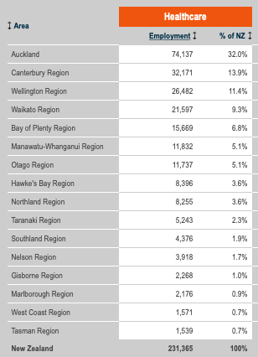
We have overlaid the RSLG lens for healthcare
Regional Skills Insights and Labour Market Data
Health care is identified as a priority industry for the region by Northland, Auckland, Waikato, BOP, Manawatū-Whanganui, Wellington, Canterbury and Otago.
Northland RSLG insights singularly focussed on healthcare and aged services, including underrepresentation of Māori workforce.
Taranaki noting difficulties and lags attracting healthcare professionals into region, with both provision and recruitment gaps.
Manawatu – Whanganui noting a strong focus for the region to develop a kaiāwhina workforce, and foundation level healthcare (and Māori healthcare) provision, including recognition of current experience and on-job training.
Notes:
The health sector, health care, and developing the health workforce is simply everywhere in the RSLG plans prepared across the country – with detailed mentions in 13 of 15 RSLG workforce plans.
Health care is identified as a priority industry for the region by Northland, Auckland, Waikato, BOP, Manawatū-Whanganui, Wellington, Canterbury, Otago.
Northland RSLG insights singularly focussed on healthcare and aged services, including underrepresentation of Māori workforce.
Auckland local insights reports highlight healthcare as third largest employer and a top labour market opportunity with micro-credentialing noted as the hot opportunity to upskill priority workforce areas. Wellbeing and mental health a top issue for employers. Its RSLG views a disjointed journey from vocational education and training to tertiary training that the Review of Vocational Education (ROVE) has not addressed.

Slide 20
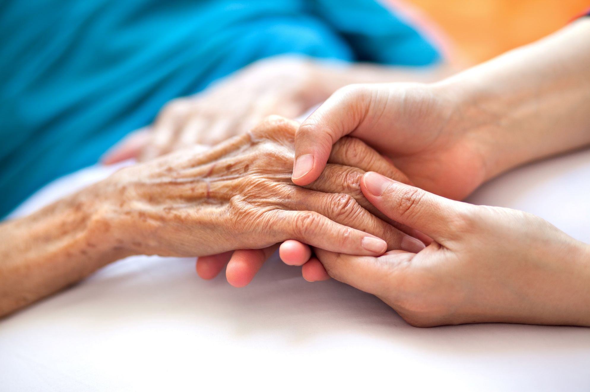
We have overlaid the RSLG lens for healthcare
Regional Skills Insights and Labour Market Data
Wellington notes wellbeing and mental health issues in workplaces, Strong demand for trained healthcare and aged care. Note while other regions claim difficult to attract workers, Wellington sees itself a victim of poaching.
Marlborough is keen to fast-track the development of medical cannabis, notes shortages in aged care and health workforce, wants to work with WDC and lobby TEC for investment.
Nelson also citing mental health concerns, and looking to support youth services organisations, and building skills pipelines to support capital development such as Nelson Hospital rebuild.
Notes:
The health sector, health care, and developing the health workforce is simply everywhere in the RSLG plans prepared across the country – with detailed mentions in 13 of 15 RSLG workforce plans.
Health care is identified as a priority industry for the region by Northland, Auckland, Waikato, BOP, Manawatū-Whanganui, Wellington, Canterbury, Otago.
Northland RSLG insights singularly focussed on healthcare and aged services, including underrepresentation of Māori workforce.
Auckland local insights reports highlight healthcare as third largest employer and a top labour market opportunity with micro-credentialing noted as the hot opportunity to upskill priority workforce areas. Wellbeing and mental health a top issue for employers. Its RSLG views a disjointed journey from vocational education and training to tertiary training that the Review of Vocational Education (ROVE) has not addressed.

Slide 21
Auckland Healthcare is the third largest employer
Top labour market opportunity.
Establishing employment working groups for people with disabilities
Supporting the government’s Working Matters Disability Employment Action Plan (WMDEAP) which aims to help ensure an inclusive employment economy where people with disabilities and health conditions can participate in employment as they want to, on an equal basis.
Developing a robust understanding of the needs of people with disabilities in Tāmaki Makaurau based on the WMDEAP.
Career stair-casing from unregulated, enrolled nursing, registered nursing, and nurse practitioners across to other medical roles removing barriers and fast-tracking local and migrant training.
Support options to allow “step-on, step-off” studying while being able to work in the sector at their current level.
Endorse and support ‘earn as you learn’ option for all fields of nursing and a fees and support structure that at least matches male dominated sectors.
Take affirmative action to fast-track migrant and existing domestic students and resident workforce at this time of acute shortages, especially in nurse-led practitioner roles.
Micro-credentialing noted as the hot opportunity to upskill priority workforce areas.
Wellbeing and mental health a top issue for employers. Its RSLG views a disjointed journey from vocational education and training to tertiary training that the Review of Vocational Education (ROVE) has not addressed.
Notes:
Auckland
Healthcare is third largest employer and a top labour market opportunity. Micro-credentialing noted as the hot opportunity to upskill priority workforce areas.
Wellbeing and mental health a top issue for employers. Its RSLG views a disjointed journey from vocational education and training to tertiary training that the Review of Vocational Education (ROVE) has not addressed.
Actions are focussed on:
Establishing employment working groups for people with disabilities
Supporting the Working Matters Disability Employment Action Plan which is an all-of government Action Plan that aims to help ensure an inclusive economic recovery from COVID-19 where people with disabilities and people with health conditions can participate in employment as they want to, on an equal basis.
Developing a robust understanding of the needs of people with disabilities in Tāmaki Makaurau based on the Working Matters Disability Employment Action Plan.
Developing alignment and career stair-casing from unregulated, enrolled nursing, registered nursing, and nurse practitioners across to other medical roles removing barriers and fast-tracking local and migrant training.
Support options to allow “step-on, step-off” studying while being able to work in the sector at their current level.
Endorse and support ‘earn as you learn’ option for all fields of nursing and a fees and support structure that at least matches male dominated sectors.
Take affirmative action to fast-track migrant and existing domestic students and resident workforce at this time of acute shortages, especially in nurse-led practitioner roles.

Slide 22
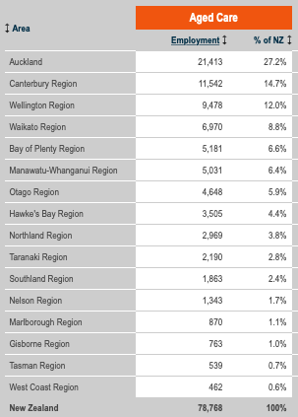
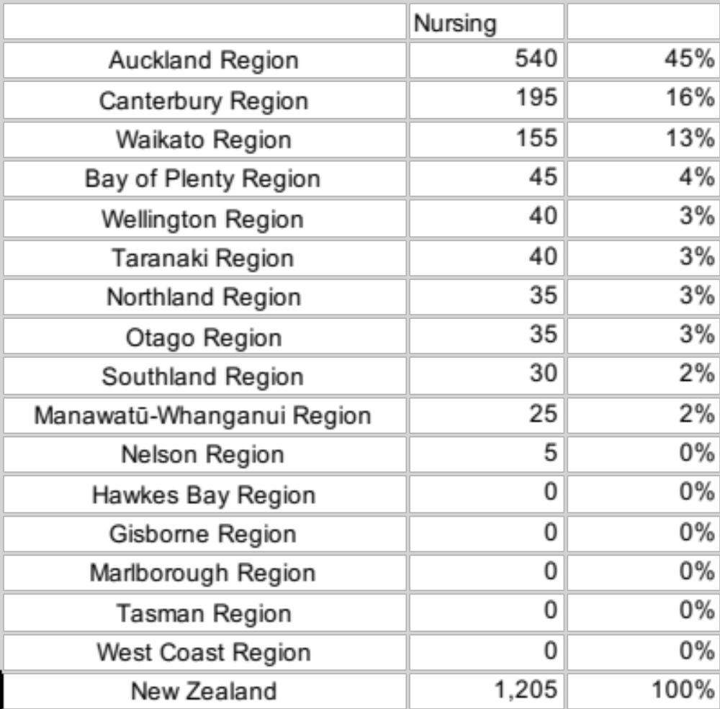
We’ve identified that there are areas which are
severely underserved
Major undersupply - 74% of course based VET level training in just three regions, with migration historically filling (or failing to fill) a large gap.
Many learners move following training suggesting poor regional outreach, particularly in regions struggling to attract care workforce. Struggles to attract younger workforce – albeit this also reflects industry preference somewhat, which will need to change.
Employment by region 2021 VET Enrolment by region
Notes:
The health sector, health care, and developing the health workforce is simply everywhere in the RSLG plans prepared across the country – with detailed mentions in 13 of 15 RSLG workforce plans.
Health care is identified as a priority industry for the region by Northland, Auckland, Waikato, BOP, Manawatū-Whanganui, Wellington, Canterbury, Otago.
Northland RSLG insights singularly focussed on healthcare and aged services, including underrepresentation of Māori workforce.
Auckland local insights reports highlight healthcare as third largest employer and a top labour market opportunity with micro-credentialing noted as the hot opportunity to upskill priority workforce areas. Wellbeing and mental health a top issue for employers. Its RSLG views a disjointed journey from vocational education and training to tertiary training that the Review of Vocational Education (ROVE) has not addressed.

Slide 23
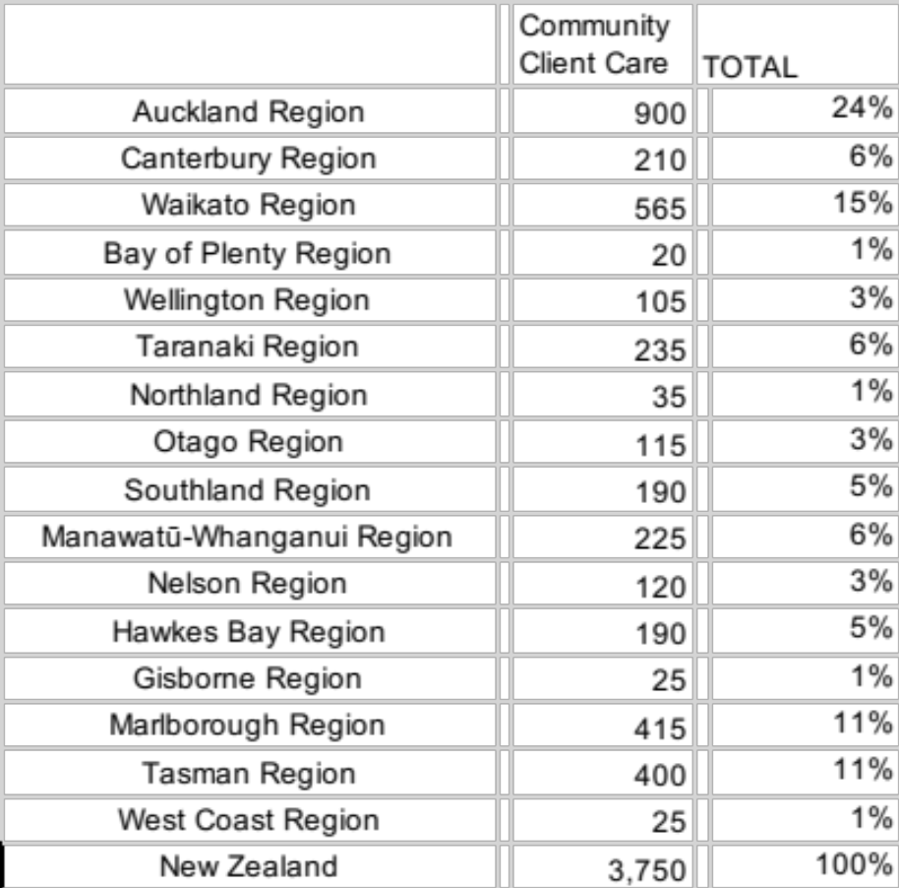

Aged Care Careerforce’s Community Client Care
We are hoping to build on previous initiatives such as
Careerforce’s Community Client Care
Careerforce Apprenticeships - 2021
Careerforce Traineeships – 2021
Careerforce’s “Community Client Care” learners - which account for 83% of its apprenticeships and 74% of its traineeships – have transferred to Te Pūkenga. Careerforce’s enrolments show a greater geographic spread than course-based provision, and make up the lion’s share of the training for the aged care industry. There is a notable and interesting overrepresentation at the top of the south, proportionate to the local population, however, as noted, these regions are still focussed on the need to attract more trained workers in health and aged care.
Over the years, related Industry Associations have expressed unhappiness with the state of industry training, and pointed the finger at the ITO, perhaps unfairly due to chronic labour shortages that an ITO cannot resolve, and wider industrial issues. It will be some time before those advocates’ high hopes for Te Pūkenga management and support will be realised, given that this training has traditionally operated as a 100 percent workplace model, with no polytechnic involvement.
Notes:
The health sector, health care, and developing the health workforce is simply everywhere in the RSLG plans prepared across the country – with detailed mentions in 13 of 15 RSLG workforce plans.
Health care is identified as a priority industry for the region by Northland, Auckland, Waikato, BOP, Manawatū-Whanganui, Wellington, Canterbury, Otago.
Northland RSLG insights singularly focussed on healthcare and aged services, including underrepresentation of Māori workforce.
Auckland local insights reports highlight healthcare as third largest employer and a top labour market opportunity with micro-credentialing noted as the hot opportunity to upskill priority workforce areas. Wellbeing and mental health a top issue for employers. Its RSLG views a disjointed journey from vocational education and training to tertiary training that the Review of Vocational Education (ROVE) has not addressed.

Slide 24

We can offer a dual delivery, work-based learning
Opportunity to blend a school and on-job model
The nursing enrolments in Careerforce reflect a partial overlap, and only a proportion will end up specifically in Aged Care roles. Careerforce’s transition option to ‘lift and shift’ into Te Pūkenga has been welcomed by some in the industry but it’s worth noting there was no Polytechnic involvement in Careerforce training, as a 100% on-job model, with entirely workplace-led assessment. It seems very unlikely that the industry – with several smaller but notably a few very large employers – would warm to a model that requires more off-job training.
Demographics, Labour Market, undersupply, and the RoVE changes make a clear case to enter the Aged Care market, particularly if it can reach (and train in and for) underserved regions.
Consulting: work with Te Hiku’s joint work plan could readily build out into health and aged care – via a Tupu-esque group training model.
VET Training enthusiasm score : 21/100
Notes:
The health sector, health care, and developing the health workforce is simply everywhere in the RSLG plans prepared across the country – with detailed mentions in 13 of 15 RSLG workforce plans.
Health care is identified as a priority industry for the region by Northland, Auckland, Waikato, BOP, Manawatū-Whanganui, Wellington, Canterbury, Otago.
Northland RSLG insights singularly focussed on healthcare and aged services, including underrepresentation of Māori workforce.
Auckland local insights reports highlight healthcare as third largest employer and a top labour market opportunity with micro-credentialing noted as the hot opportunity to upskill priority workforce areas. Wellbeing and mental health a top issue for employers. Its RSLG views a disjointed journey from vocational education and training to tertiary training that the Review of Vocational Education (ROVE) has not addressed.

Slide 25
For the pathways to be successful, we need long term
commitment from our partners
Any concept proposed by Skills will need to consider whether the preferred focus is on upskilling to build a stronger kaiāwhina workforce, or look to pathways to nursing qualifications (enrolled/registered). Focus on either option (or pursuing both) will require significant investment.
In particular, supporting pathways to nursing qualifications could require a long term commitment to a sustained plan of action. Skills would need to have a high level of confidence of ongoing commitment from its partners, including key stakeholders. It is forseeable that Te Pukenga will want to step into this space in the medium to longer term and this needs to be considered – either as a potential investment risk, or a complementary collaborative player.
In the absence of a long term partnering commitment, Skills might be better placed to look at initiatives which strengthen the kaiāwhina workforce and also serve the purpose of addressing key competency areas for nursing. These areas are more likely to garner support from kaiāwhina, consumers and employers.
MANDATORIES
Whatever options are selected we need to:
Focus strongly on developing key stakeholder relationships – employers, consumers, kaiāwhina, Māori and Pasifika, health sector entitities
Continue to build our own capability in matauranga Māori
Not duplicate effort happening elsewhere
Use co-design models to develop initiatives which will have meanginful impact
Notes:
Reviewed a large number of health sector reviews and reports. Of significance is 2020 the Health and Disability System Review which looked at systemic levers for sustainable change, leading to the development of the new national structure for health delivery in NZ.
Takeouts from the Kaiāwhina Workforce Development PlanEmbrace new ways of working: digital/technology developments including virtual engagements, webinar learning and sharing, e-study groups.
From Goal 5 of the Plan:
Matching orientation/induction to qualifications.
Accelerate workforce capability and capacity to respond to new and emerging roles and services (not defined).
Implement new pre-employment and in-work training approaches.
Value and enable ongoing professional and interprofessional development opportunities for kaiāwhina.
Engage with consumers, whānau and kaiāwhina to ensure training content is informed by them and where possible includes their voices as part of the training delivery.
Realise opportunities to increase kaiāwhina cultural confidence and competence, learning from and building on successful community and employer development initiatives.
Identify agile education and training approaches to respond to sector workforce demand and supply - and the increasingly complex consumer needs.
Partner with NZQA, WDC etc. to establish pathways for the workforce including from school to work, the unemployed and for those already in work.
Identify barriers and solutions to achieving pathways into registered (health) roles.
Utilise initiatives like the Calderdale Framework to expand the skill sets of kaiāwhina to support more integrated care and better respond to the needs of whānau and communities.
“A system which doesn’t reflect mātauranga Māori or enhance rangatiratanga will not be effective at improving health and welbeing for Māori.”
Calderdale Framework: https://calderdaleframework.com/framework/ Model for workforce development delivered by trained practitioners.
Health and Disability System Review, March 2020 p6 Executive Summary

Slide 26

For the pathways to be successful we need
strong relationships with our stakeholders
Microcredentials with a practical application for kaiāwhina appear to be the best fit.
If these can also contribute to a pathway to (say) EN or RN, that would be beneficial. Examples of this would be cultural capability and digital fluency.
Competence areas tested in the State Final exams also offer areas where nursing pathway development would be helpful for kaiāwhina developing in their roles, and for school leavers looking to enter – for example numeracy as it relates to medical calculations, or interpersonal relationships. These are areas of nursing competence which readily lend themselves to a microcredential (certainly at a foundational level).
The recommended employer stakeholder partnerships are with Māori entities, rather than Pasifika, and looking at rural areas of need. Northland would fit this criteria. Critical to success is our ability to partner with Māori entities. In discussion with Nancy Purvis, Skills Te Ao Māori lead, she suggested a pilot for proof of concept with in an organisation she has connections with. They are looking at cultural competency for their kaiāwhina workforce.
Notes:
Reviewed a large number of health sector reviews and reports. Of significance is 2020 the Health and Disability System Review which looked at systemic levers for sustainable change, leading to the development of the new national structure for health delivery in NZ.
Takeouts from the Kaiāwhina Workforce Development PlanEmbrace new ways of working: digital/technology developments including virtual engagements, webinar learning and sharing, e-study groups.
From Goal 5 of the Plan:
Matching orientation/induction to qualifications.
Accelerate workforce capability and capacity to respond to new and emerging roles and services (not defined).
Implement new pre-employment and in-work training approaches.
Value and enable ongoing professional and interprofessional development opportunities for kaiāwhina.
Engage with consumers, whānau and kaiāwhina to ensure training content is informed by them and where possible includes their voices as part of the training delivery.
Realise opportunities to increase kaiāwhina cultural confidence and competence, learning from and building on successful community and employer development initiatives.
Identify agile education and training approaches to respond to sector workforce demand and supply - and the increasingly complex consumer needs.
Partner with NZQA, WDC etc. to establish pathways for the workforce including from school to work, the unemployed and for those already in work.
Identify barriers and solutions to achieving pathways into registered (health) roles.
Utilise initiatives like the Calderdale Framework to expand the skill sets of kaiāwhina to support more integrated care and better respond to the needs of whānau and communities.
“A system which doesn’t reflect mātauranga Māori or enhance rangatiratanga will not be effective at improving health and welbeing for Māori.”
Calderdale Framework: https://calderdaleframework.com/framework/ Model for workforce development delivered by trained practitioners.
Health and Disability System Review, March 2020 p6 Executive Summary

Slide 27
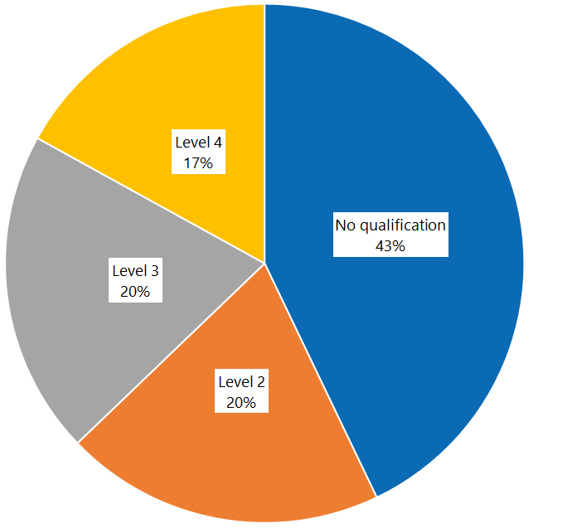
Kaiāwhina Workforce Development
How Skills can contribute to the development of the Kaiāwhina
Appendix A: Kaiāwhina Qualification Demographics^{[i]}
Home and community support, mental health and addiction, and disability sectors: comparison of qualification levels by numbers of workers
Employees in the February 2019 data were matched with data from the 2017/18 full-year data, to assess whether workers progressed through the qualification levels. This process matched 22,787 employees (79 percent of eligible workers in the February 2019 data).
As of February 2019, there were 4,086 (14 percent) new workers; that is, workers who had started after 30 June 2018. This mostly explains why 21 percent of the data does not match. Other reasons are providers merging and changing employee identifiers.
The detailed data captured in 2017/18 allows us to analyse data by sector, though it should be noted that this applies to only 16,785 support workers of the total 22,787.
Figure 1: Percentage of workers in home and community support, mental health and addiction and disability sectors, by qualification level, 2017/18
^{[i]} Source: https://www.health.govt.nz/publication/care-and-support-workforce-qualification-attainment

Slide 28
Kaiāwhina Workforce Development
Appendix B: Health Workforce Advisory Board
Extract: Annual Report to the Minister of Health (emphasis added)
January 2022
A positive example of COVID-19 health workforce disruption is the development of vaccinator assistants to relieve reliance on registered nurses during the vaccination campaigns of 2021. This was a Ministry initiative strongly supported by HWAB and DHBs. Changes of scopes of practice (with supervision) which have previously been resisted and new competency and training programmes were rapidly developed for online delivery in response to the pandemic. More than 300 have been trained, 50 are fully authorised and working in the field and 50% of those who trained are Māori.
Long term opportunities to build an auxiliary workforce and retain this new skill set exist for continuing pandemic responsiveness to booster shots and to vaccinating younger New Zealanders in 2022. In the future, vaccinator assistants as an auxiliary workforce can have a legacy effect in vaccination by helping to address New Zealand’s worrying fall in childhood immunisation statistics particularly among Māori and Pacific peoples.
This has been identified as a priority activity for regional health governance during the transition period.
https://www.health.govt.nz/publication/health-workforce-advisory-board-2021-annual-report-minister-health
Health Workforce Advisory Board minutes received 24 September,2021.

